Slide 2
Try This, Catch That, Finally
An Explanation on PowerCLI Error Handling

Slide 3

Justin Sider
Chief Information Officer, Belay Technologies

Slide 4






About Me
Blog
Invoke-automation.blog
Twitter(X)/Slack/GitHub
jpsider
VMware Programs
VMUG Advantage
VMUG Board of Directors
vExpert x10
VMware Code Coach 20-25

Slide 5
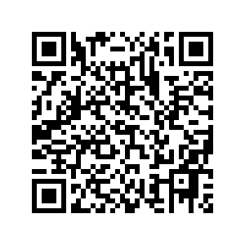
Agenda
Terminating Errors
Non-Terminating Errors
ErrorAction Thingys
Try & Catch
Finally
PowerCLI Demo!
API Demo!
Questions?
Link to Code!

Slide 6
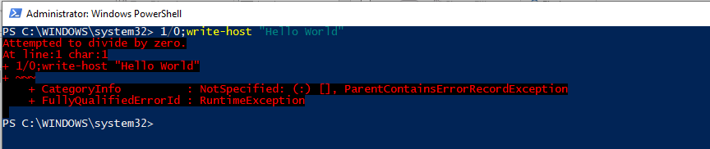
Terminating Errors
It stops or halts the execution of the script so that the commands in the next lines cannot be executed.

Slide 7
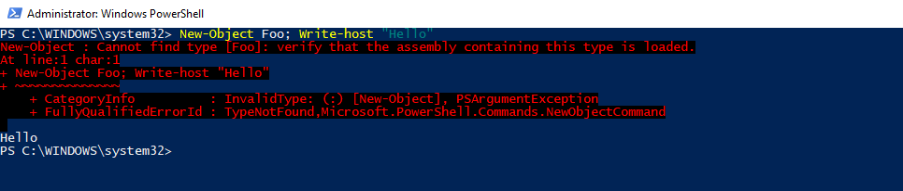
Non-Terminating Errors
Are generally generated by internal cmdlets and automatically handled by them, but the error does not terminate the execution of the pipeline.

Slide 8
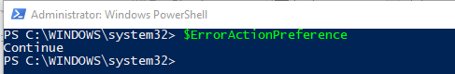
ErrorAction Thingys
$ErrorActionPreference
Only responds to Non-terminating Errors
Console/Script Specific
-ErrorAction Parameter
Specific to a command
Overrides $ErrorActionPreference
Options
SilentlyContinue, Stop, Continue, Inquire, Ignore, Suspend, Break

Slide 9
Try & Catch
Try {
Run a command
}
Catch {
Capture the problem. Maybe log about it. But it allows you to continue.
}
Note: Catch is REQUIRED with a Try.

Slide 10



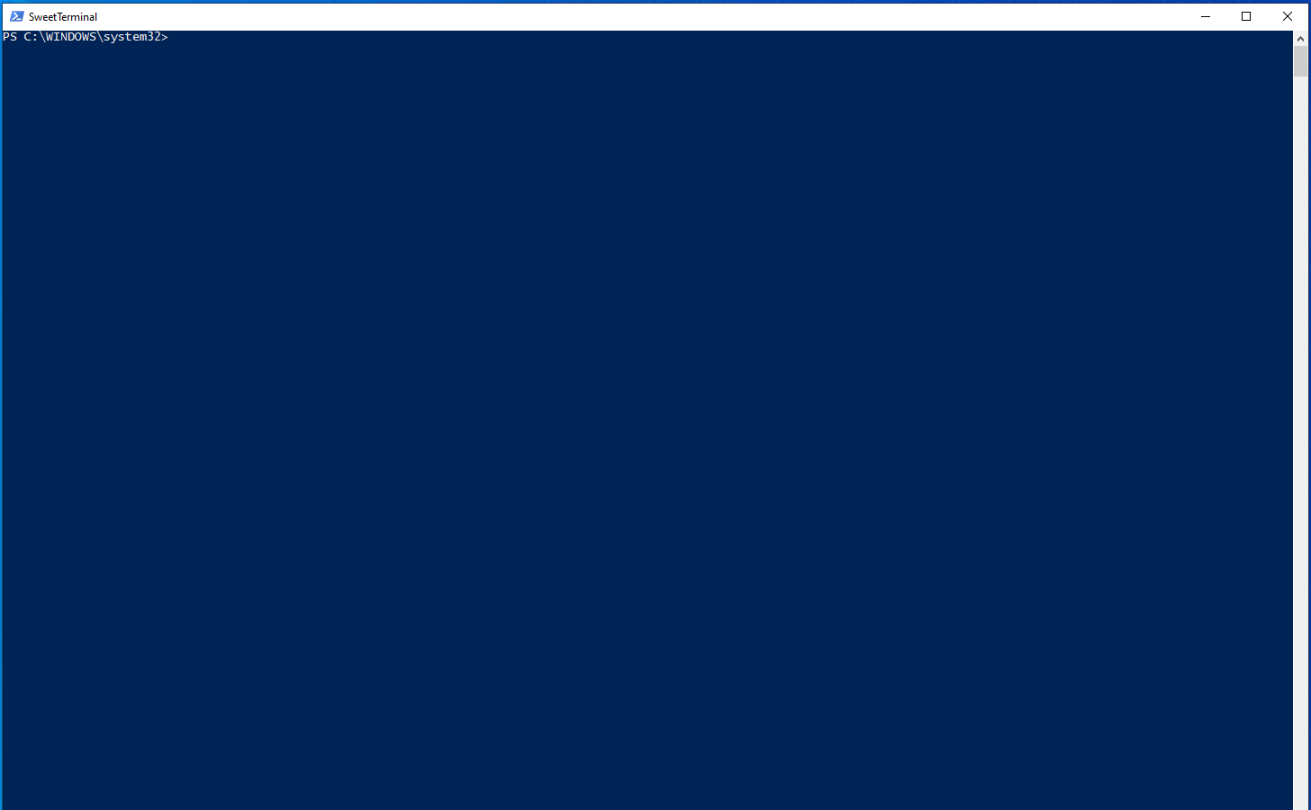

Demo Time !

Slide 11

API Demo

Slide 12
You can do this!

Slide 13
Questions?
Link to Code!

